Slide 1
Maternal Mortality
A case study of maternal health outcomes during birthing events in the United States

Slide 2
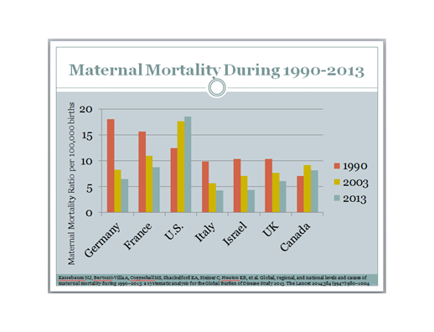
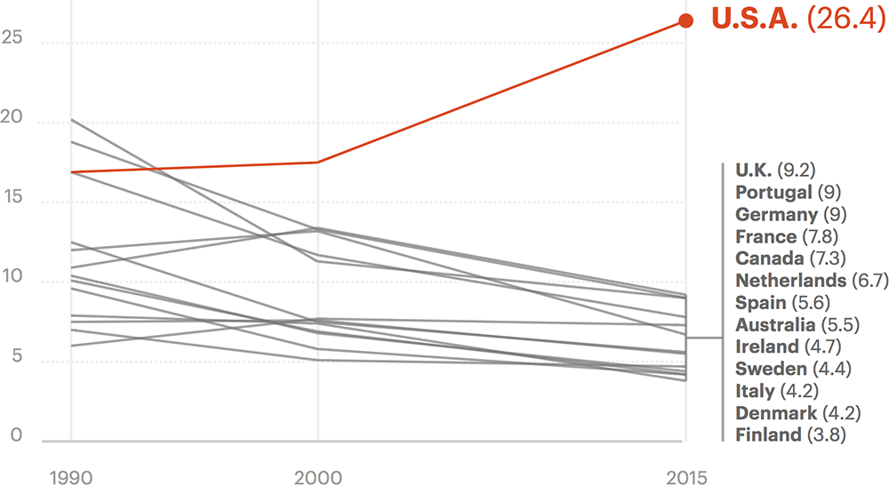
Why so many mamas dying in the US?
Maternal Mortality
The United States is the only developed nation in which the rate of maternal mortality is increasing.

Slide 3
Census & CDC Data: 28 Million records covering an 8 yr period were imported into a SQL database.
Flask application was built using SQLAlchemy to wrangle data into digestible JSON.
HTML5 and Javascript were used to process JSON for visualizations & regression results.
1
2
3
4
5
Data was summarized by year, race, and age cohort. A 1% random sample DB was also created.
StatsModels library used to dynamically perform regression analysis in application

Slide 4
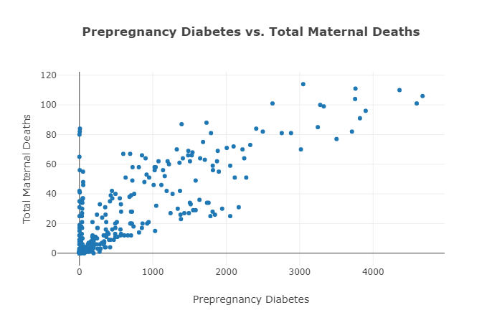
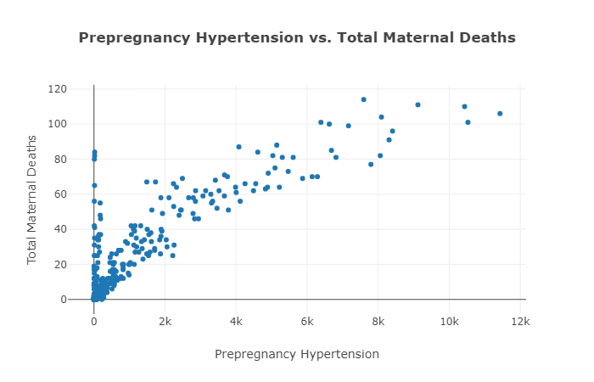
Pre-pregnancy Morbidity Factors

Slide 5
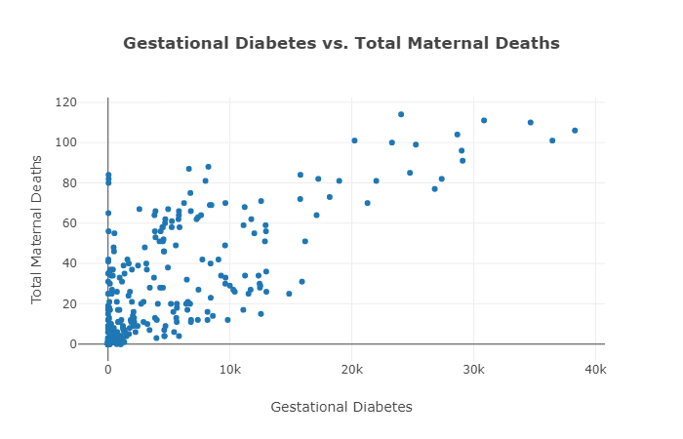
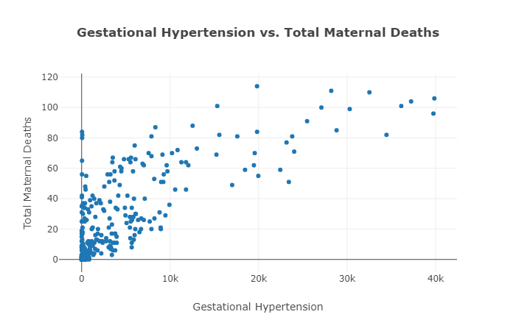
Gestational Morbidity Factors

Slide 6
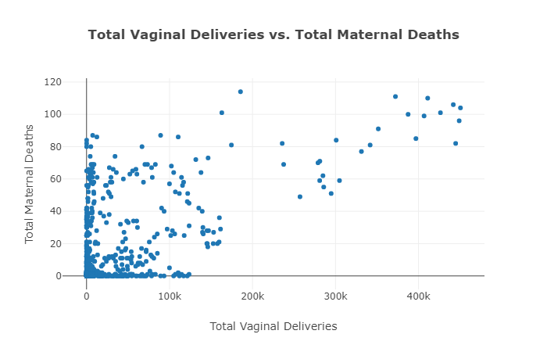
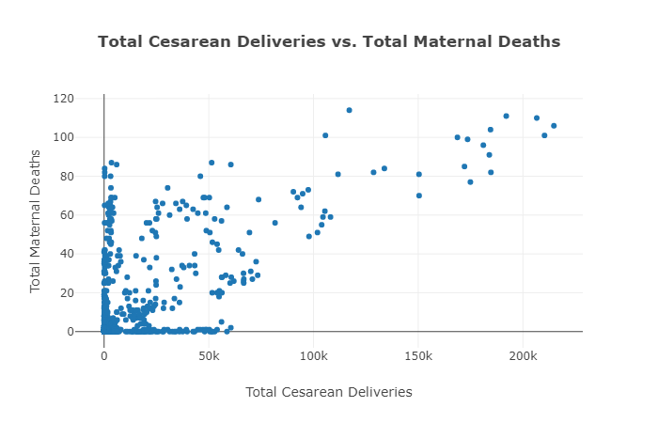
Comparing Methods of Delivery

Slide 7
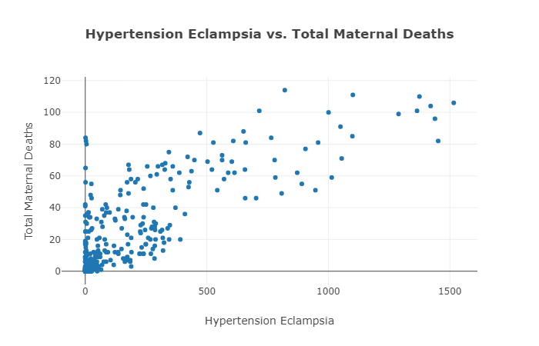
(Pre)Eclampsia

Slide 8
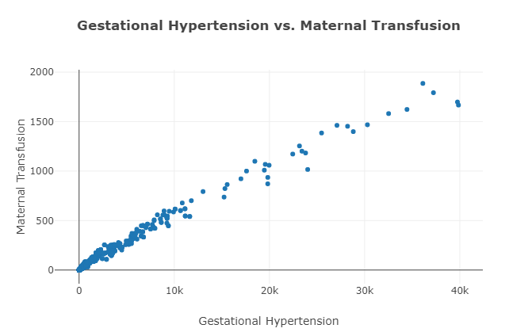
Focusing on Hypertension..

Slide 9
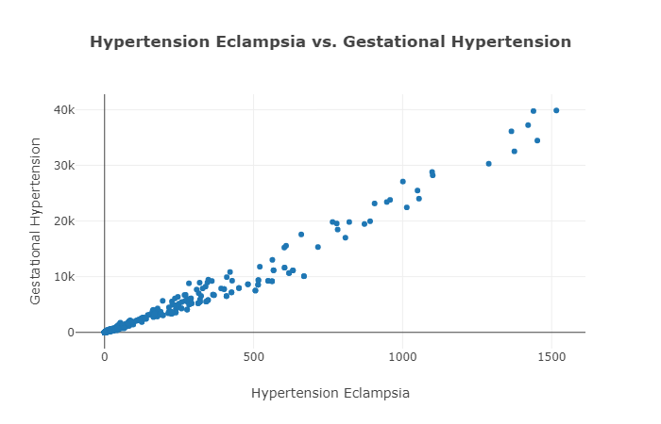
Strong Linear Correlations

Slide 10
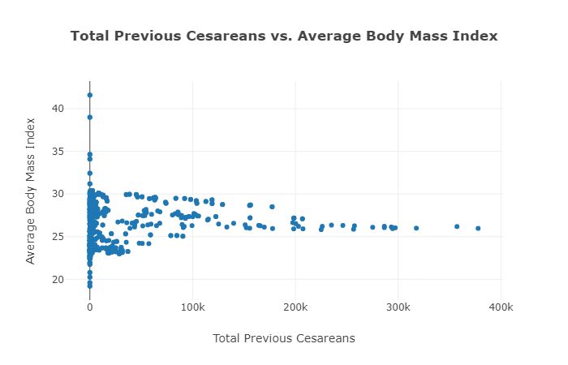
Validating Data

Slide 11
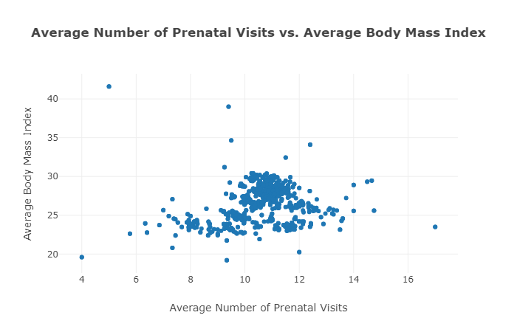
Validating Data

Slide 12
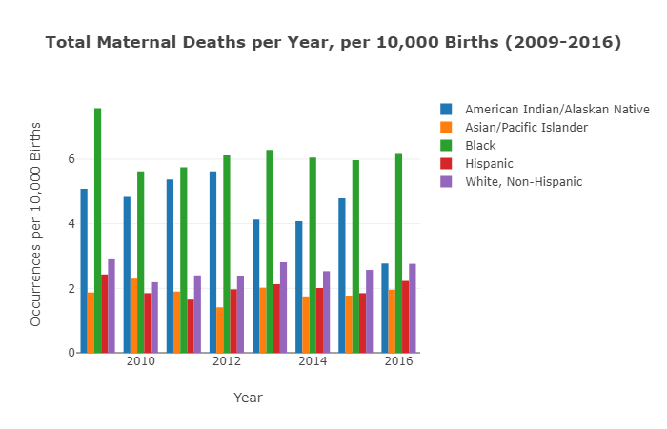
Racial disparities in total maternal deaths

Slide 13
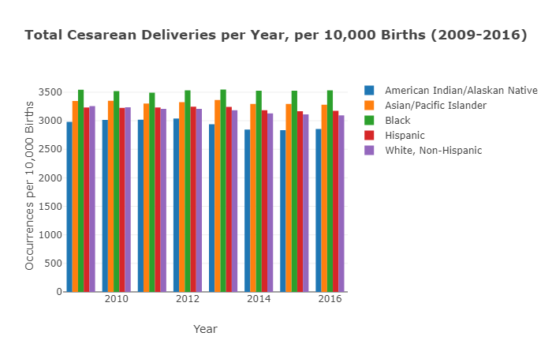
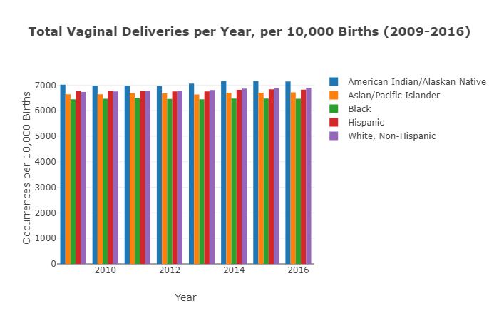
Racial disparity and delivery methods

Slide 14
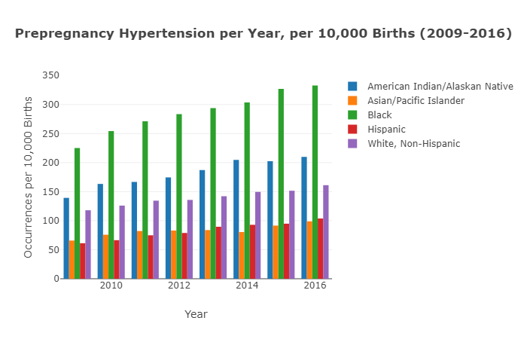
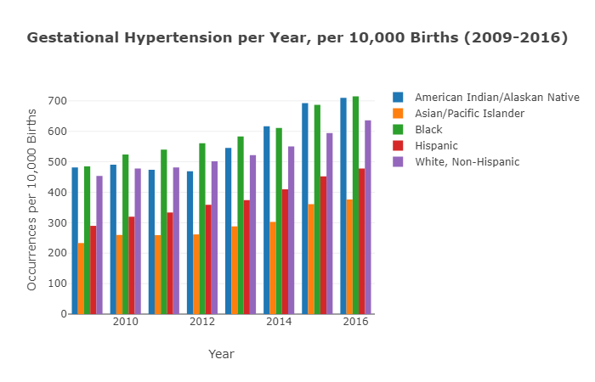
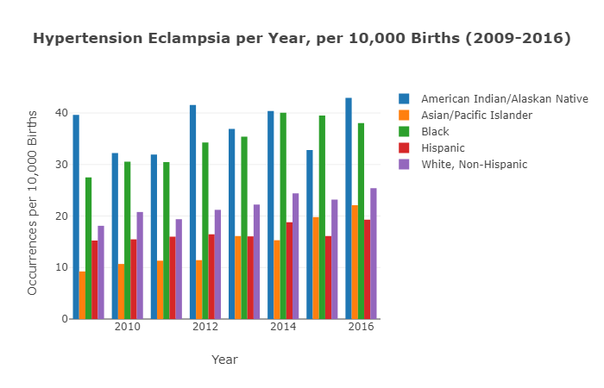
Hypertension: leading risk factor among
Black and American/Indian women

Slide 15
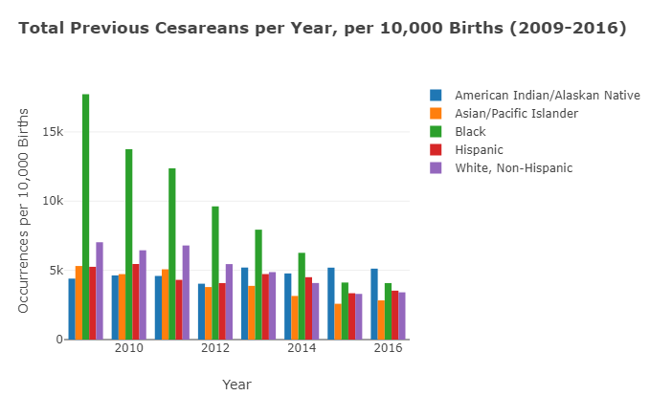
Effort to reduce Caesarean births

Slide 16
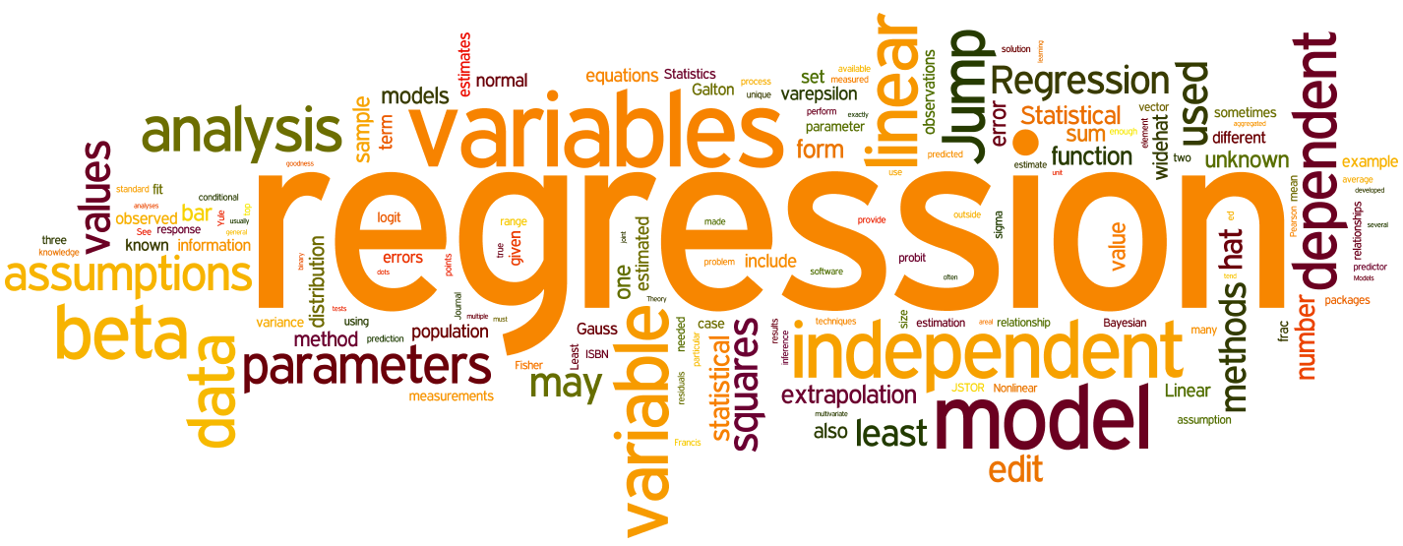
REGRESSION ANALYSIS

Slide 17
LINEAR REGRESSION: One Dependent Variable on the Y axis and one independent variable on the X axis.
Could have used least squares or gradient descent. We used least squares for this project, which minimizes the squared error between each point and the data in our line.
MULTIVARIATE REGRESSION: One Dependent variable but MULTIPLE independent variables. Ex: Carolina Panthers winning games.
USEFUL PYTHON LIBRARIES FOR REGRESSION:
SCIPY
STATSMODELS
NUMPY
PANDAS
SCI-KIT - LEARN
CODE EXAMPLE: FROM SCIPY IMPORT STATS

Slide 18
How do we measure Regression?
With the Coefficient of determination/R Squared.
It is the statistical measure of how close our data fits our regression line.
Calculated by: 1 - sum of the squared errors/sum of the squared variation from the mean.
Ranges on a scale from 0 to 1.
An R squared value of 0 would mean none of the variance is captured
An R squared value of 1 would mean all of the variance is captured.

